Slide 1

Functional Java 8 (from Scratch)

Slide 2

Overview
Intro to the example 5’
Code! 20’
Wrap Up 10’
Discussion 20’

Slide 3
Payroll
Intro to the example
We are going to build a simple payroll application. These are the business rules described by the HR department:
We need to pay our employees their wage using our trusted banking partner.
Employees employed with a regular salary (fixed amount monthly) should get their salary regardless of the hours tracked in the time tracking system
Employees employed with a hourly salary should get the salary calculated using their recorded hours (hours worked X hourly salary)
Employees are identified by their employee number

Slide 4
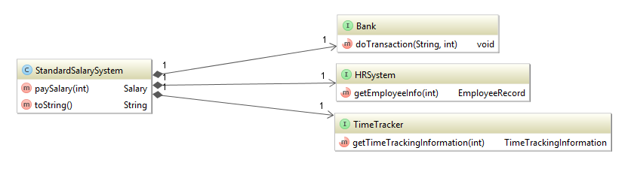
Payroll
Intro to the example

Slide 5

Let’s do it! (?)
Intro to the example (continued)

Slide 6
Let’s do it!
Intro to the example (continued)
An employee might not yet be registered in the HR system
An employee might not have information entered to the time tracking system
If the salary cannot be paid, this has to be signalled to the legacy ERP system calling our service
The salary should be paid only if the employee is active

Slide 7
Let’s do it!
Live coding session

Slide 8
What have we done?
We created an abstraction for null checks!
Or: We created an abstraction for computation which may optionally return a value.
Does it work for other things as well?

Slide 9
Payroll
Intro to the example (continued…)
No matter what technical error occurs, the system should return a valid response, so that the ERP system can continue doing the payroll

Slide 10
Let’s do it!
Live coding session

Slide 11
What have we done?
We replaced the try language construct with a type!
How did we do that? Using the same functions as before using a constructor and
M<T>.flatMap(f: v -> M<U>): M<U>
Are there even more possible types using this structure?

Slide 12
What offers the JDK 8
Do we really need to implement that stuff on our own?
Nullable is called Optional in JDK 8
 | Optional<T> | Stream<T> | CompletableFuture<T>
construtor | of(…), ofNullable(…) | list.stream(), Arrays.stream(…) | supplyAsync(() -> U) M<T>
map | map | map | thenApply, thenApplyAsync
flatMap | flatMap | flatMap | thenCompose

Slide 13

Discussion / Questions / Feedback

